Slide 1


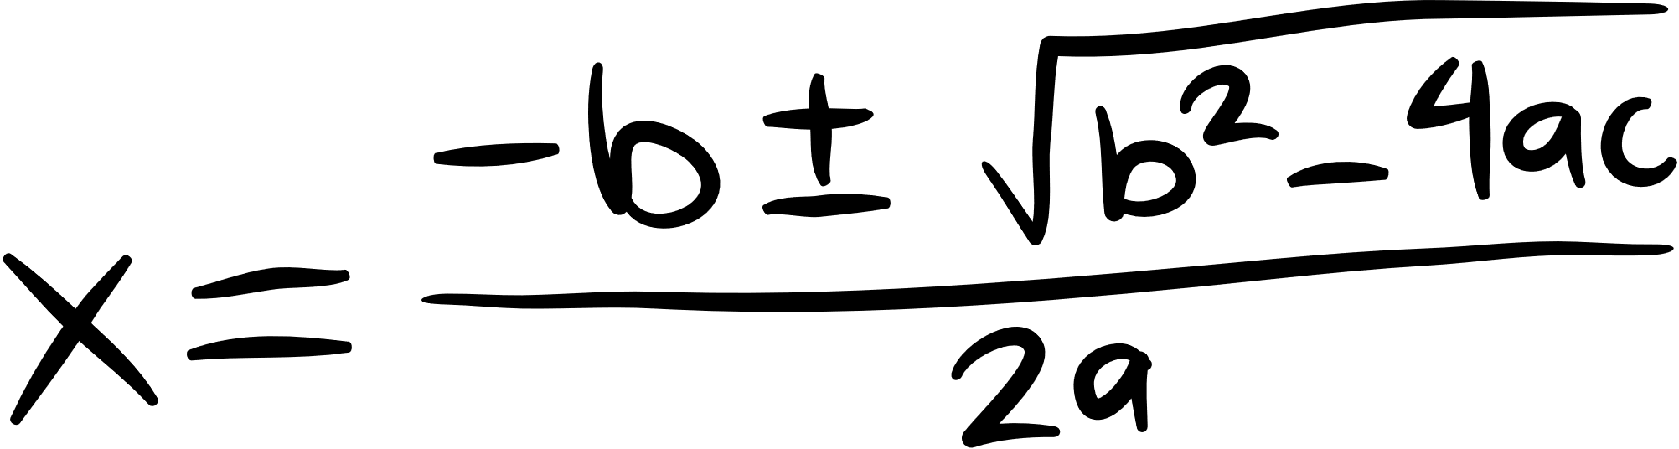
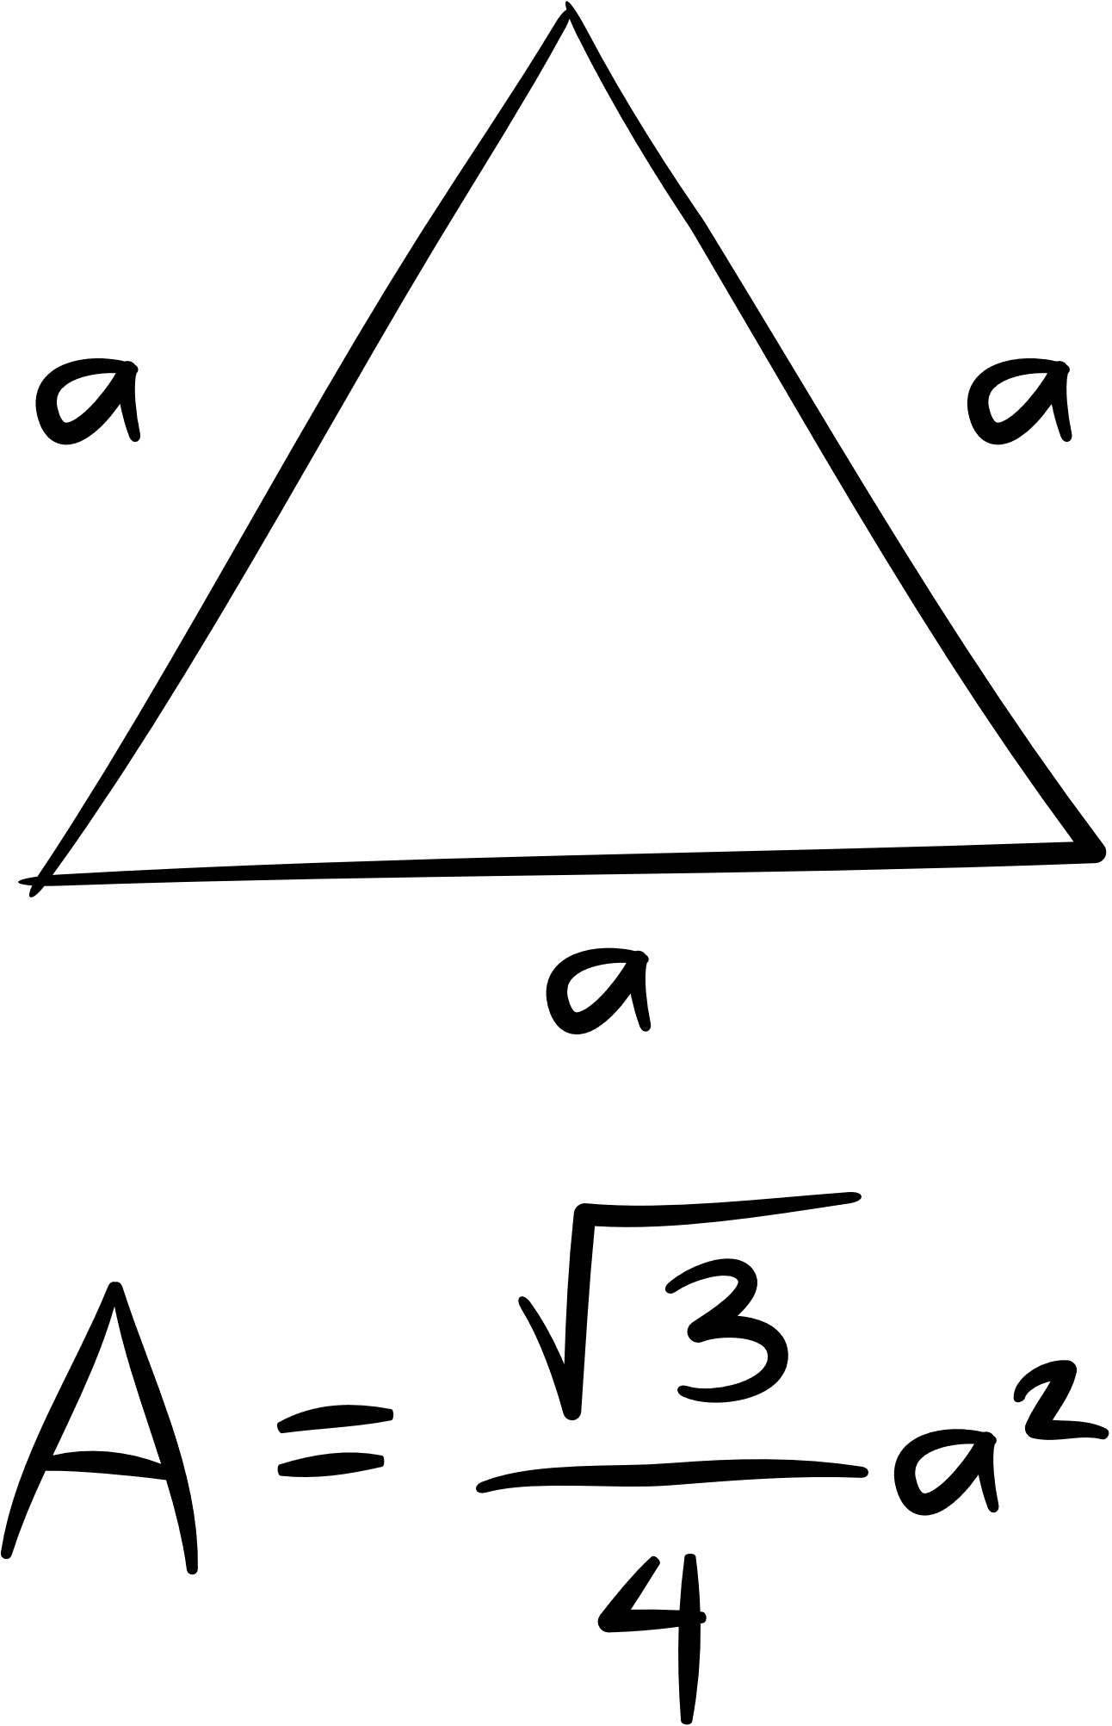

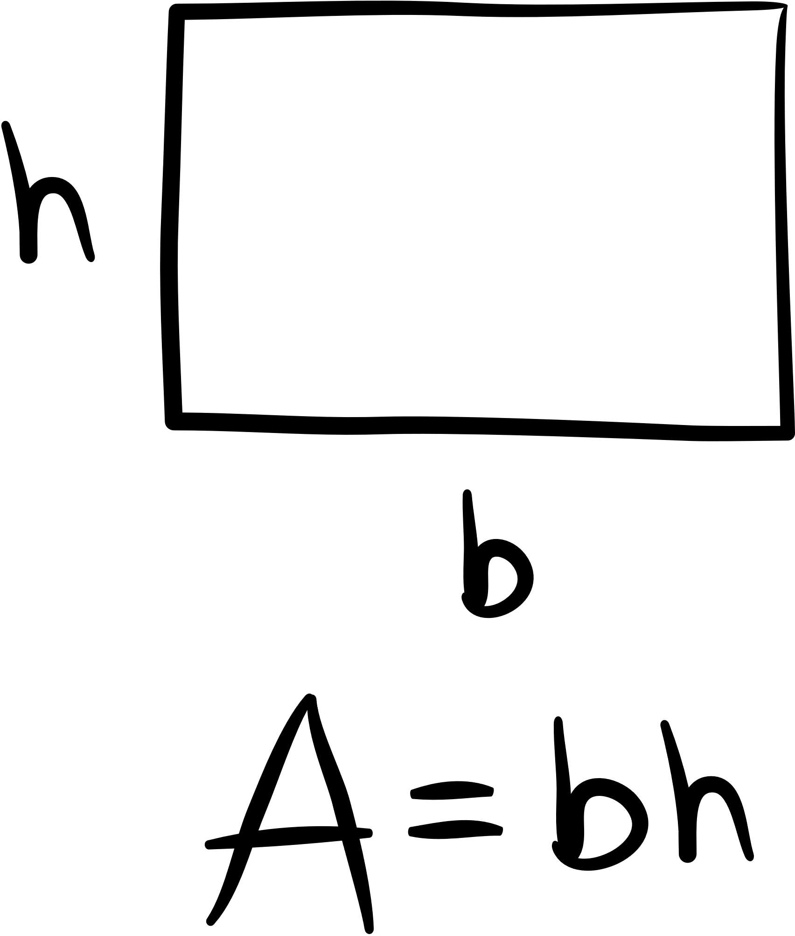
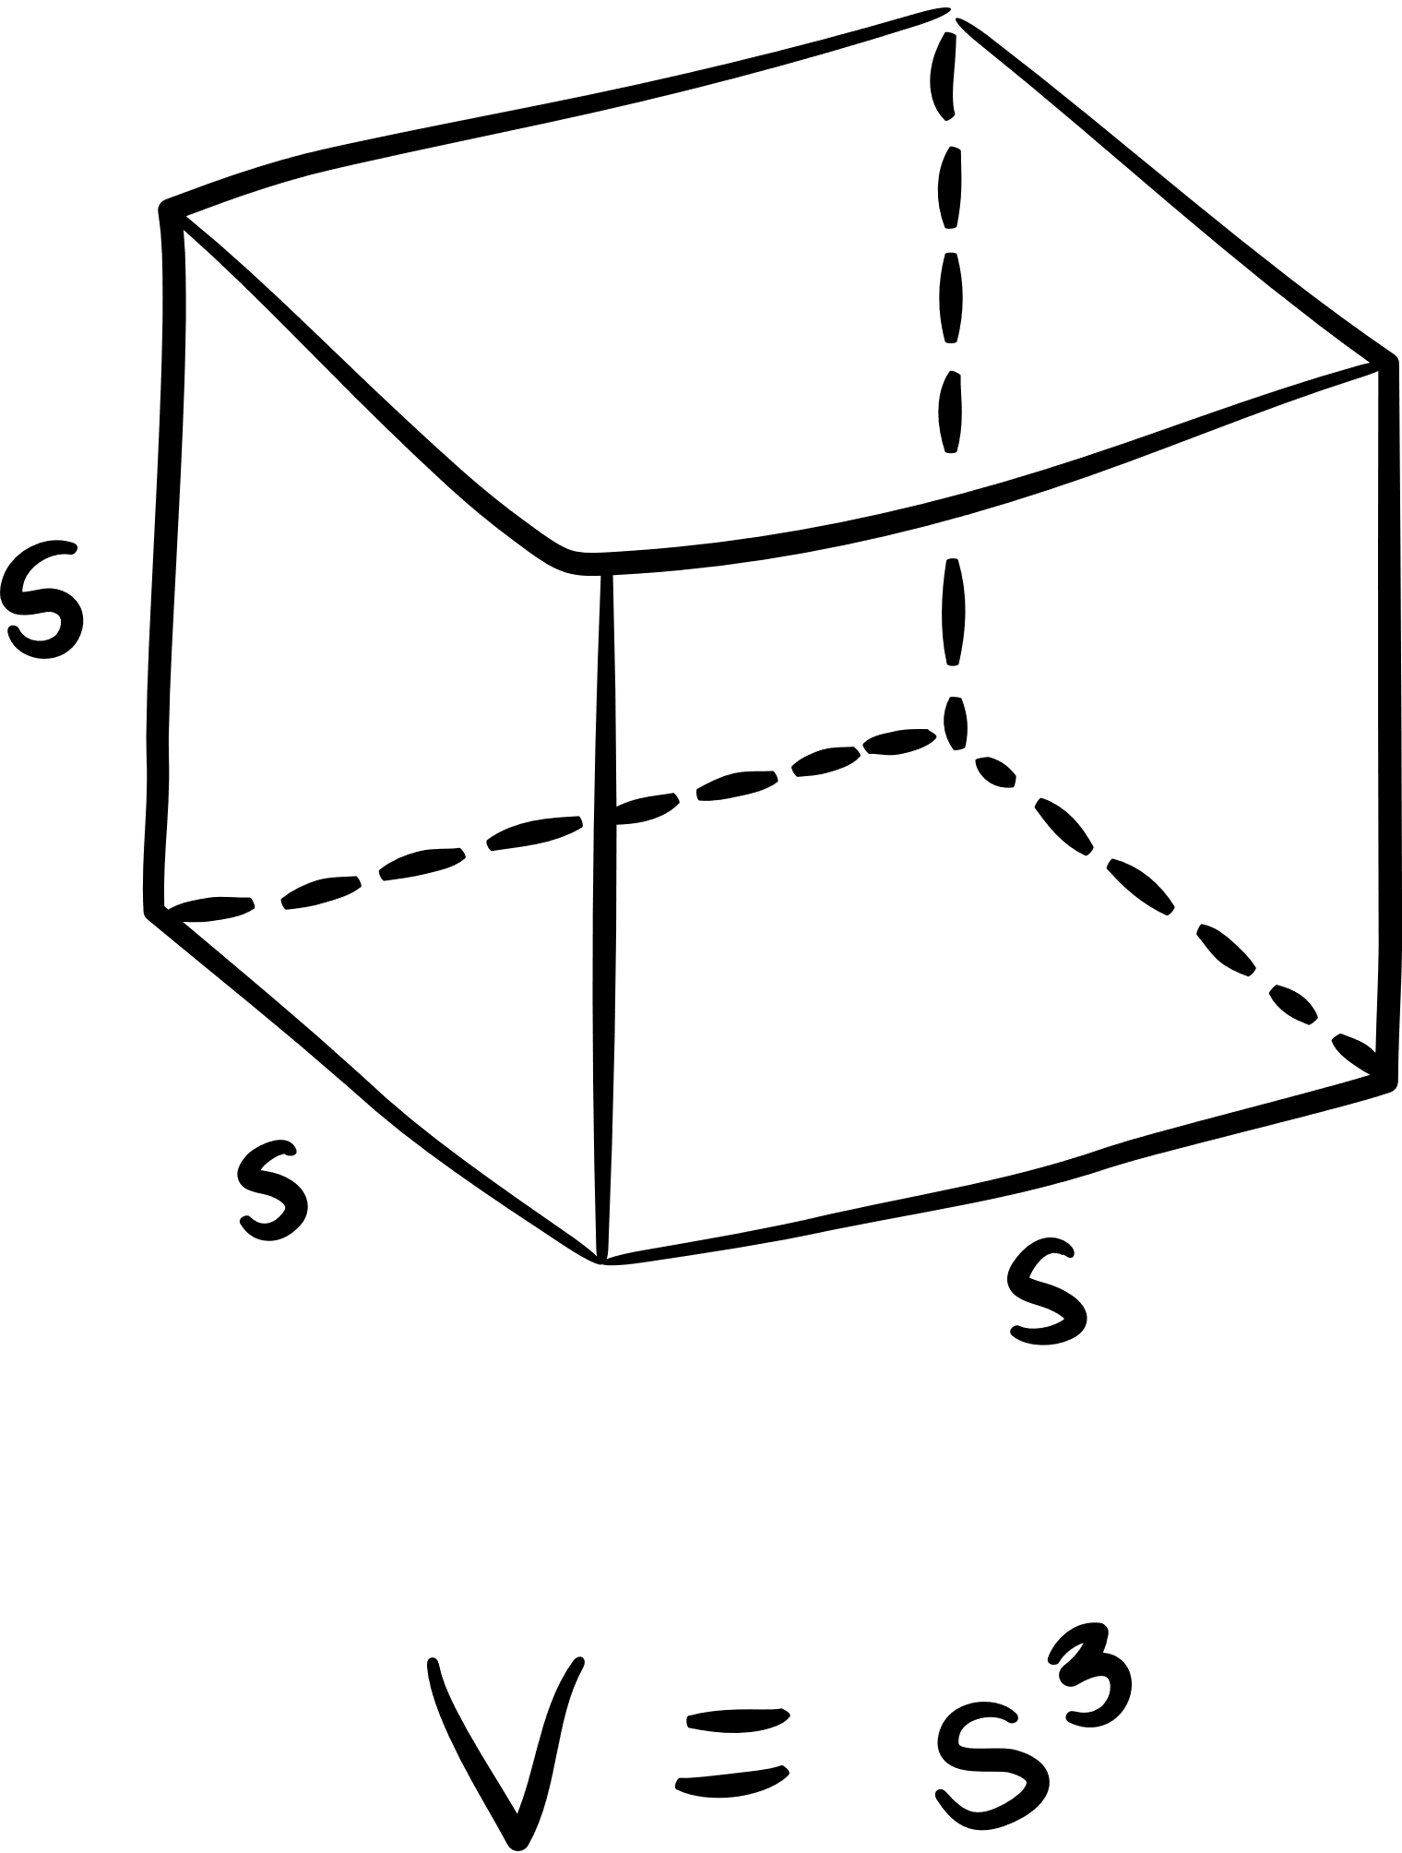
WELCOME TO THE
math olympics
by Mladen Zivanovic

Slide 2





OVERVIEW
  CONNECTING MATH WITH REAL LIFE
  MAKING THE TASK MEET OBJECTIVES
  ASSESSING THE KNOWLEDGE OF YOUR STUDENTS

Slide 3
TASK
INTRODUCTION
YOU'VE BEEN BROUGHT ON BOARD BY ÍÞRÓTTASAMBAND ÍSLANDS WITH A UNIQUE TASK:
PROMOTING ICELAND AS THE IDEAL HOST FOR THE 2036 OLYMPICS.
HOWEVER, A BRILLIANT CONCEPT HAS EMERGED:
- ADVOCATING FOR ICELAND AS THE HOST NATION.

Slide 4
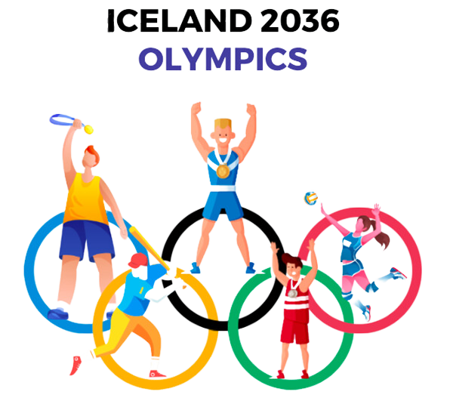
TASK
TASK
YOU ARE GOING TO TAKE A ROLE OF AN URBAN CITY PLANNER.
IN THE SPIRIT OF THE OLYMPICS, YOUR OBJECTIVE IS TO HARNESS YOUR CREATIVITY AND TO CRAFT A BLUEPRINT FOR VENUES THAT WILL HOST THIS PRESTIGIOUS EVENT

Slide 5
TASK
TASK
IN THIS ACTIVITY, ALL NEIGHBORHOODS ACROSS ICELAND HAVE THE OPPORTUNITY TO PARTICIPATE AND SHOWCASE THEIR CAPABILITY TO CONSTRUCT OLYMPIC STADIUMS SUITABLE FOR HOSTING A TOTAL OF 40 DIFFERENT SPORTS. TO ACHIEVE THIS, THE TASK IS DIVIDED AMONG TEAMS OF EXPERTS, INCLUDING YOURSELF.

Slide 6
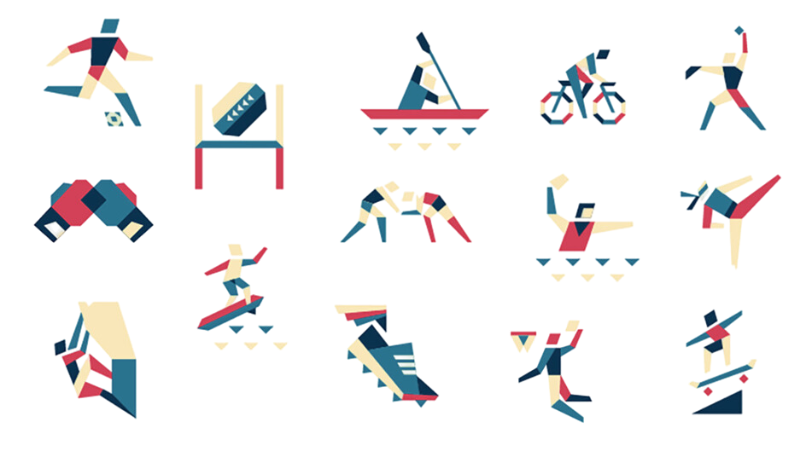
TASK
TERMS AND CONDITIONS
TWO URBAN CITY PLANNERS WORK TOGETHER TO DESIGN A PROPOSAL FOR NEIGHBOURHOOD THAT WILL HOST 3 SPORTS MAX.
YOU WILL DRAFT A PROPOSAL FOR A NEIGHBORHOOD
FOLLOWING THIS PHASE, PLEASE, ENSURE THAT THE SPORT ARENAS ARE DESIGNED TO MEET THE SPECIFIC DIMENSIONS AND REQUIREMENTS OF EACH RESPECTIVE SPORT.

Slide 7
TASK
TERMS AND CONDITIONS
YOUR TASK IS TO RESEARCH AND DETERMINE THE PRECISE DIMENSIONS OF THEIR RESPECTIVE FIELDS AND ARENAS.
CONSIDER ALLOCATING SPACE FOR SPECTATORS AND SOCIAL EVENTS.
Also, do not forget about that each Olympics neighborhood should prominently feature the iconic Olympics logo, which consists of five interlocking circles, This logo should be displayed in one section of your neighborhood design.

Slide 8
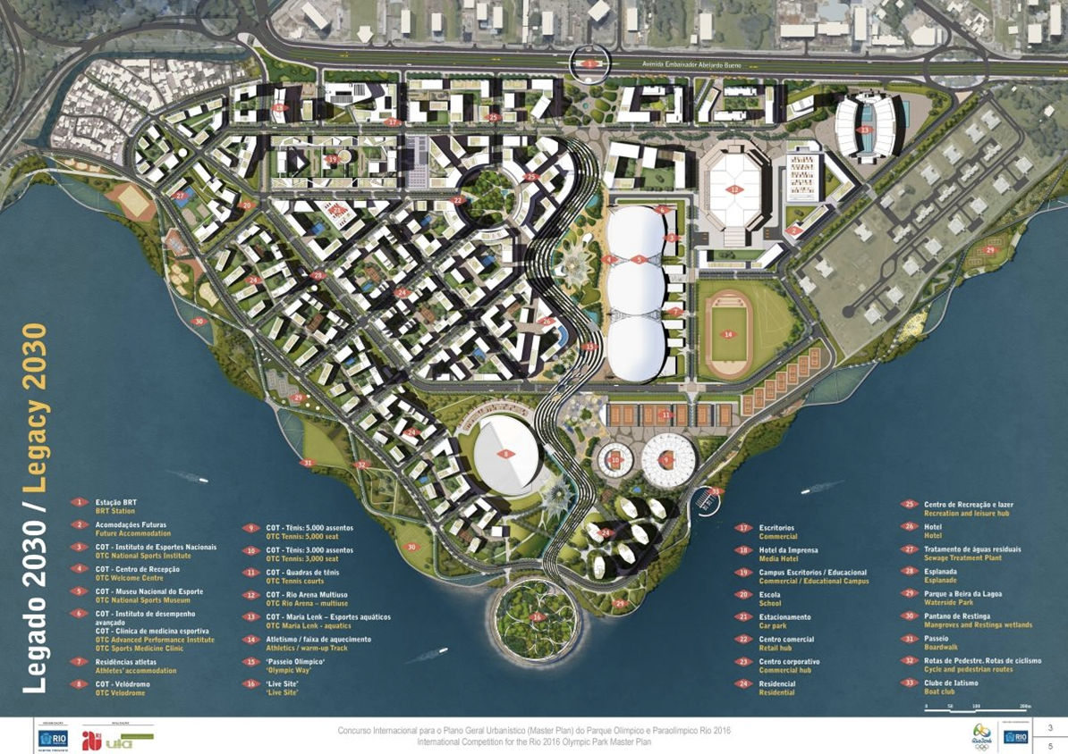

Slide 9
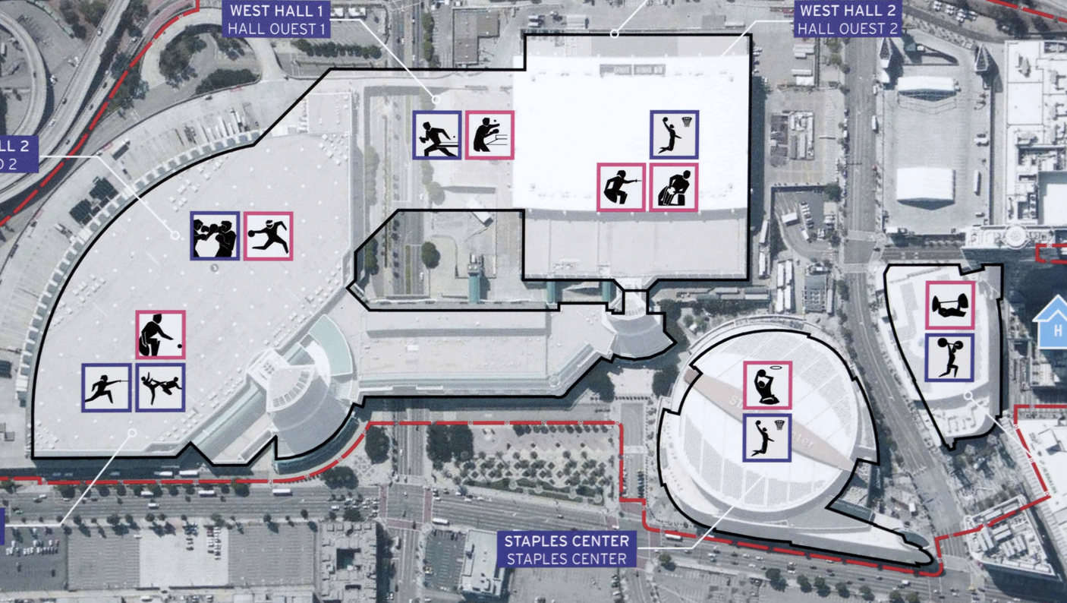

Slide 10
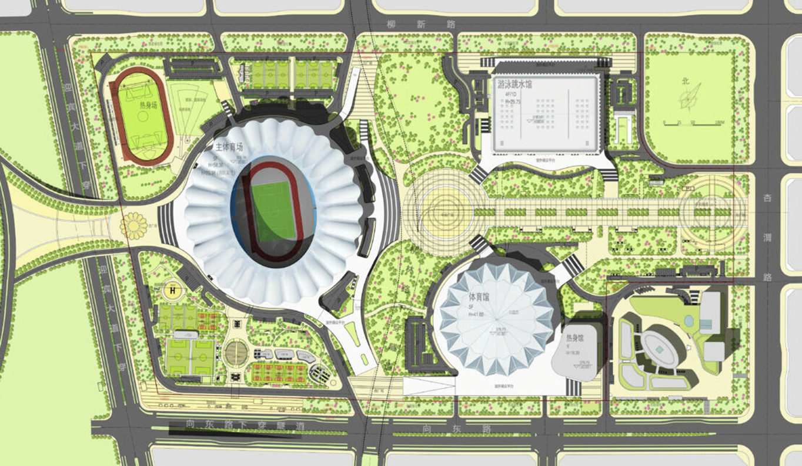

Slide 11
TASK
OVERVIEW
INSTRUCTIONS:
1. **Neighborhood Selection**: Choose a neighborhood for your Olympic project. Your teacher will provide a printed map of the selected area.
2. **Sports Selection**: Collaborate with your partner planner to select three sports for your neighborhood.
3. **Coordinate System**: Determine the central point or coordinate system for your neighborhood, which will serve as the reference point for your designs.
4. **Circular Arena**: Design one of your sports arenas in a circular shape and provide the equation defining the circle's dimensions.
5. **Quadrilateral Arena**: Create one of your sports arenas in a quadrilateral shape and specify the coordinates of its vertices.
6. **Polygon Arena**: For the third sports arena, select any polygon shape and calculate its perimeter.
7. **Olympics Circle Logo**: Incorporate the Olympics Circle logo into your neighborhood design. Provide the equations for each of the five interlocking circles representing continents.
8. **Cultural and Heritage Street**: Identify a street in your neighborhood that will be dedicated to Cultural and Heritage activities. Write the equations for the parallel lines that outline this street.
9. **Olympic Square**: Locate a perpendicular cross-section where the main Olympic Square will be situated. Write the equations for the perpendicular lines that define this area.
10. **Progress Report**: Compile a progress report detailing how your Olympic Neighborhood meets all the specified criteria.

Slide 12
Let’s make that neighborhood now!
Enter the code for GeoGebra Classroom
SMYR 9C4W
OR geogebra.org/classroom/smyr9c4w
Link to GeoGebra Lesson - https://www.geogebra.org/m/xepcuwmm

Slide 13
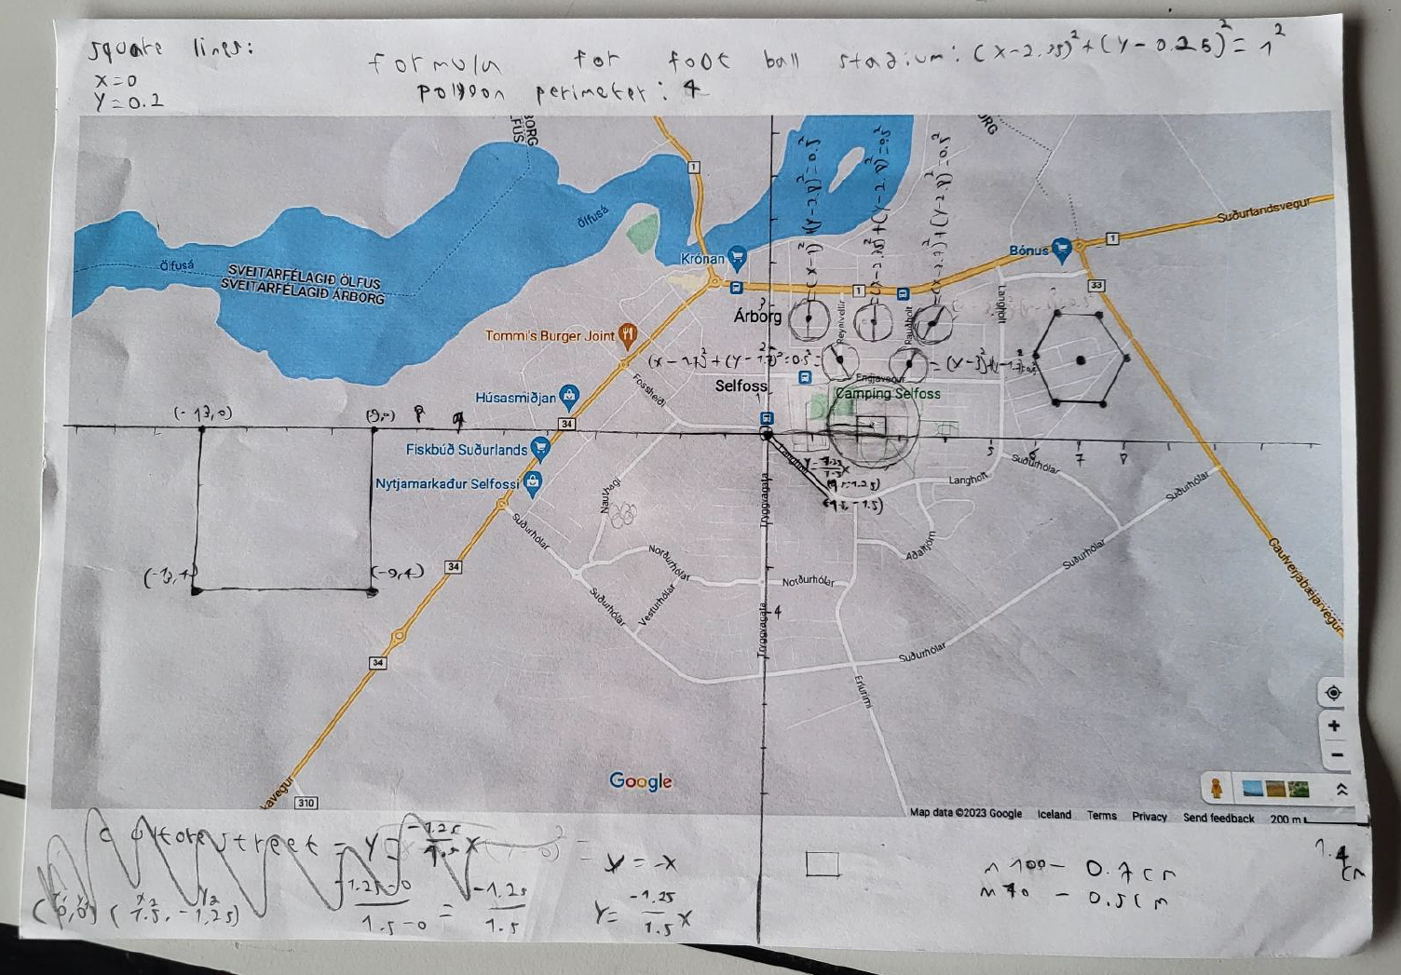
Examples

Slide 14
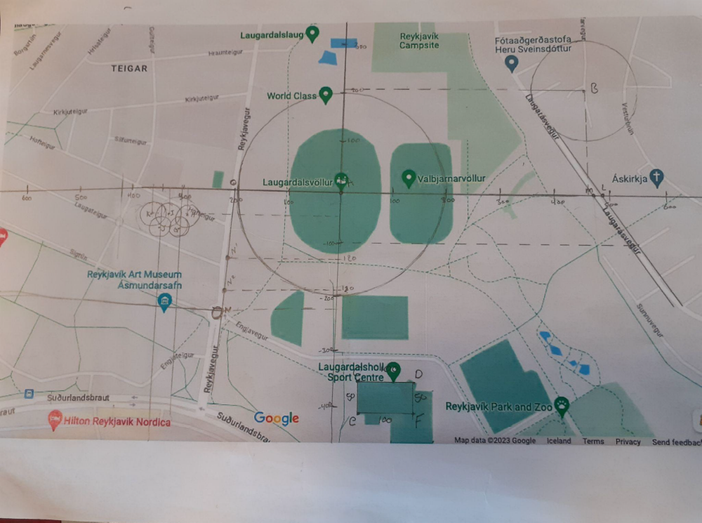
Examples

Slide 15
WHAT IS THE BACKGROUND?
  GRASPS PROJECT DESIGN
  USING COORDINATE GEOMETRY
  ASSESSMENT THORUGH A PROJECT

Slide 16
GRASPS
  GOAL: A DEFINITION OF THE PROBLEM OR GOAL
  Role: Define the role of the student
  Audience: Identify the target audience
  Situation: This is the context or scenario of the goal
  Product: What is created and why it will be created
  Standards: Rubrics or success criteria

Slide 17
GRASPS
FOR THE OLYMPIC PROJECT
  GOAL: PITCH ICELAND TO HOST OLYMPICS
  Role: city planner
  Audience: olympic committee
  Situation: olympics 2036 hosting
  Product: blueprint of a neighbourhood
  Standards: terms and conditions for each sport

Slide 18
COORDINATE GEOMETRY
WHAT ARE TOPICS EXPLORED?
  LINEAR FUNCTION
  EQUATION OF A CIRCLE
  PERPENDICULAR LINE
  PARALLEL LINES
  POLYGONS

Slide 19
COORDINATE GEOMETRY
HOW TO PREPARE STUDENTS
SIMILAR PROJECTS:
CITY MAPPING - READING COORDINATES FROM GOOGLE MAPS - CITY BUS LINE - ROAD TRIP PLANINNG - ...

Slide 20
COORDINATE GEOMETRY
HOW LONG DOES IT TAKE TO FINISH THE PROJECT?
DEPENDS ON YOUR STUDNETS BUT
1X40 FOR CHOOSING THE NEIGHBOURHOOD AND SPORTS
2X40 DESIGNING THE NEIGHBOURHOOD
2X40 ADJUSTING THE EQUATIONS AND MATHEMATICAL FORMS
1X40 FOR WRITING A REPORT

Slide 21
COORDINATE GEOMETRY
WHAT HAVE STUDNETS LEARNED AND DEVELOPED DURING THE PROJECT/ASSESSMENT?
  SPATIAL DESIGN AND PLANNING: ABILITY TO PLAN AN OLYMPIC NEIGHBORHOOD LAYOUT.
  GEOMETRY AND EQUATIONS PROFICIENCY: COMPETENCE IN APPLYING GEOMETRY AND EQUATIONS.
  COLLABORATION AND COMMUNICATION: EFFECTIVENESS IN WORKING WITH A PARTNER AND COMMUNICATING IDEAS.
  PROBLEM SOLVING: SKILLS IN FINDING SOLUTIONS FOR VENUE PLACEMENT.
  CRITICAL THINKING AND CRITERIA FULFILLMENT: EVALUATING FULFILLMENT OF DESIGN CRITERIA.

Slide 22

Connect with Mladen on LinkedIn
www.Linkedin.com/in/mladenzivanovic11

Slide 23
Thank you!

